Slide 1
Introduction To Deep Learning
Module-1

Slide 2
Machine learning
Machine learning is a branch of Artificial Intelligence that focuses on developing models and algorithms.
That let computers learn from historical data with certain pattern without being explicitly programmed for every task.

Slide 3
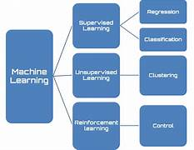
Machine Learning is mainly divided into three core types: Supervised, Unsupervised and Reinforcement Learning
Supervised Learning: Trains models on labeled data to predict or classify new, unseen data.
Unsupervised Learning: Finds patterns or groups in unlabeled data, like clustering or dimensionality reduction.
Reinforcement Learning: Learns through trial and error to maximize rewards, ideal for decision-making tasks.

Slide 4
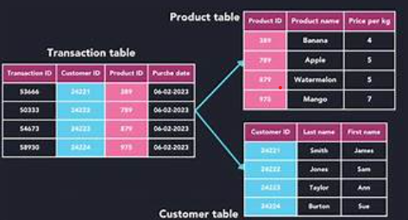
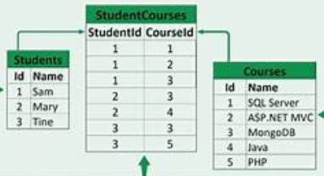
Structural data

Slide 5

Image , video , audio , sensor, text files

Slide 6
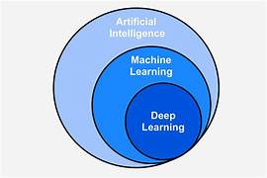
AI vs ML vs DL

Slide 7
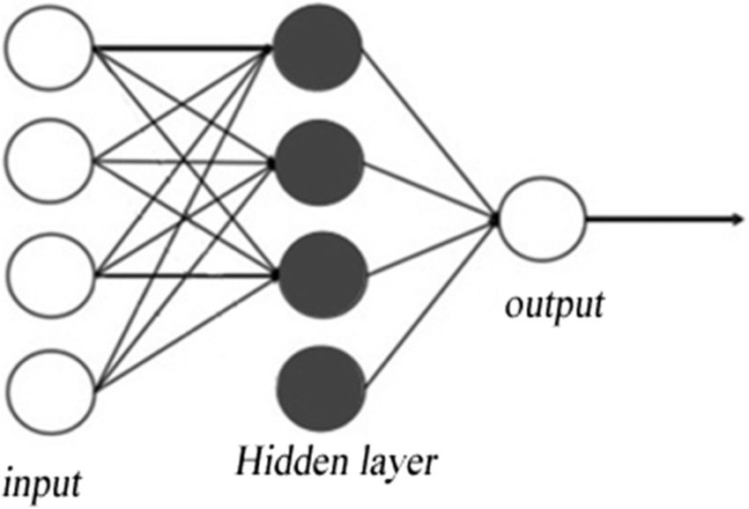
Shallow learning
1)One input layer, one hidden layer and one output layer
2)Supervised algorithm
3)Store less memory
4)Lower dimensional

Slide 8
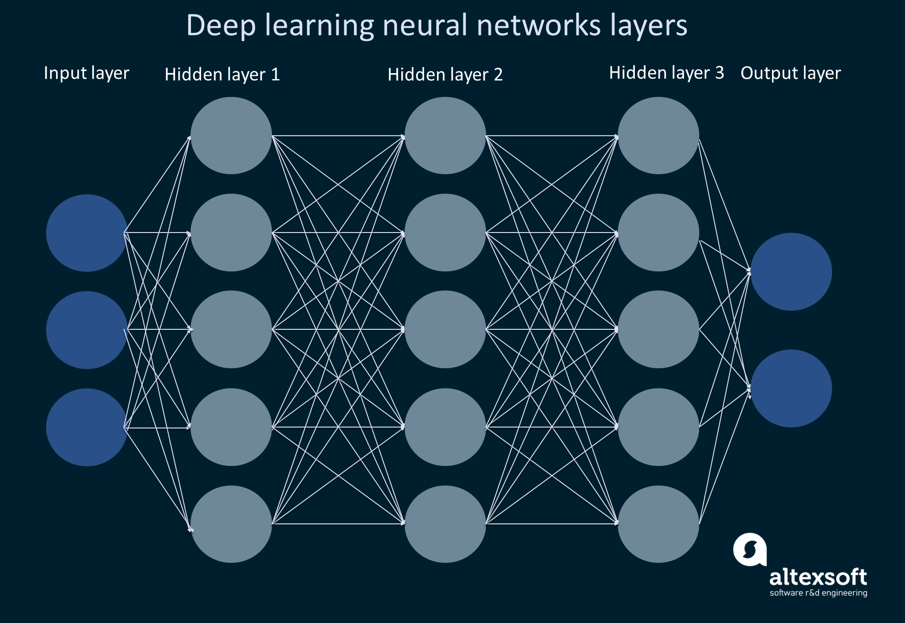
Deep learning
1)Large data sample
2)Many hidden layer
3)Unsupervised learning
4)More memory space
5)High dimensional

Slide 9
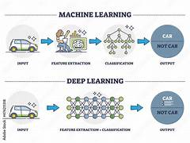
Feature Extraction in ML vs DL
Ml:
1)Constructing a pattern recognition
2)Level of abstraction
3)Feature extraction of raw data
4)Classification
Dl:
1)Set of rules and algorithms for feature extraction for raw data
2)Higher and more number of hidden layer
3)Each pixel will detect edge region and corner region
4)Training the data automatically

Slide 10
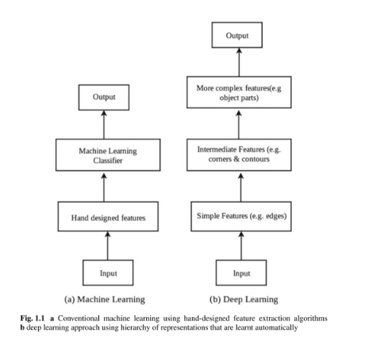
Hand-designed feature extraction algorithms of machine learning and deep learning

Slide 11
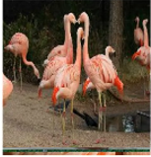
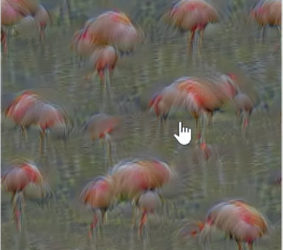
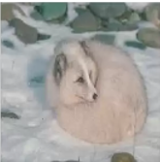
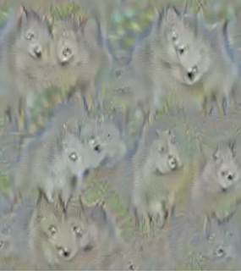

Slide 12
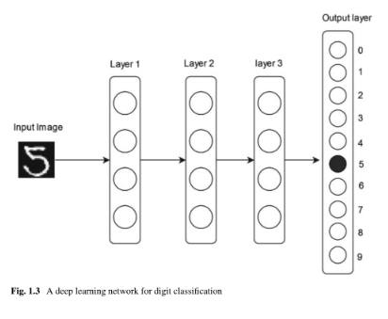
Deep Learning Network For Digit Classification

Slide 13
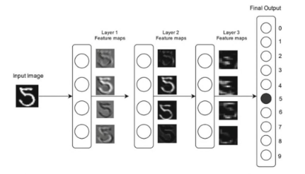
1)Constructs features at multiple level with higher features
2)Fast-growing field for problem of feature extraction
3)Multiple filter on the information
4)Mathematical framework

Slide 14
Module -2
Convolutional Neural Network Models

Slide 15
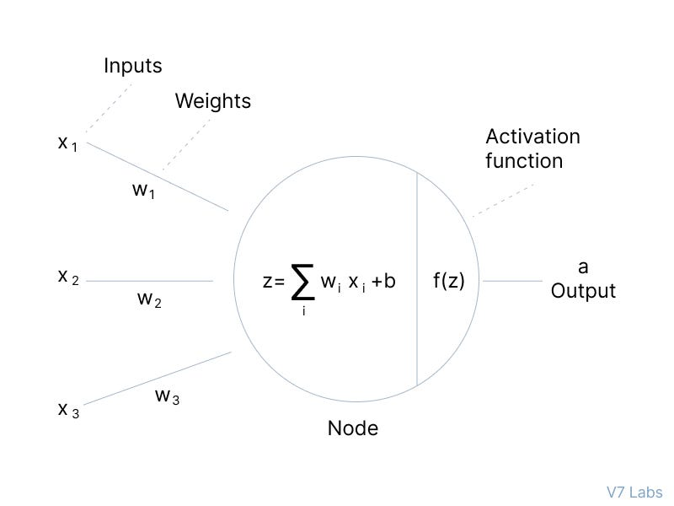

Slide 16
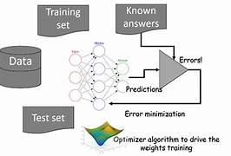
Deep learning works

Slide 17
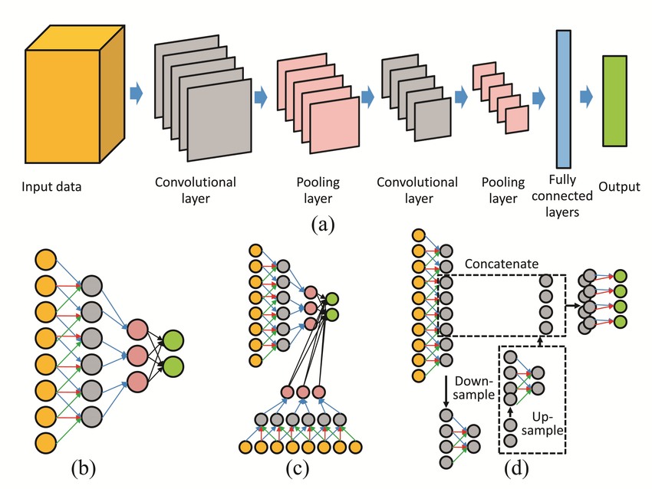

Slide 18
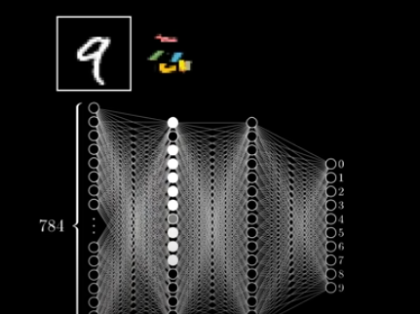

Slide 19
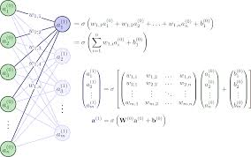
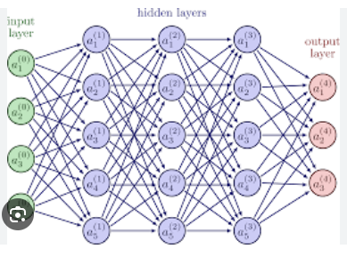

Slide 20
Activation Function
Non -linearity into the model, allowing the network to learn and represent complex patterns in the data
Sigmoid Function
Tanh Activation Function
ReLU (Rectified Linear Unit) Function
Softmax Function
SoftPlus Function

Slide 21

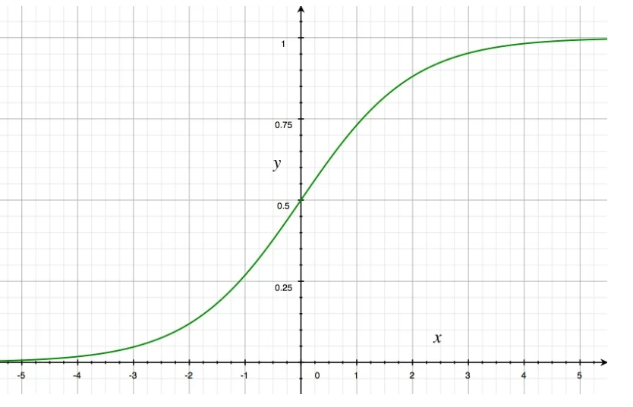
Sigmoid Function
Sigmoid Activation Function is characterized by 'S' shape. It is mathematically defined .This formula ensures a smooth and continuous output that is essential for gradient-based optimization methods.

Slide 22
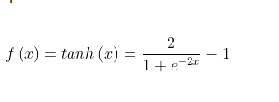
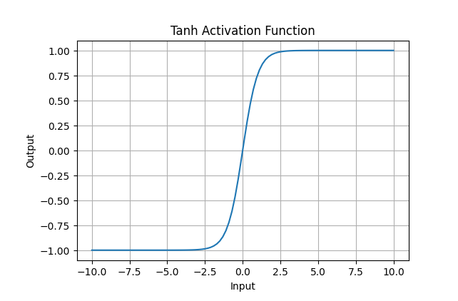
Tanh Activation Function(hyperbolic tangent function)
Value Range: Outputs values from -1 to +1.
Non-linear: Enables modeling of complex data patterns.

Slide 23

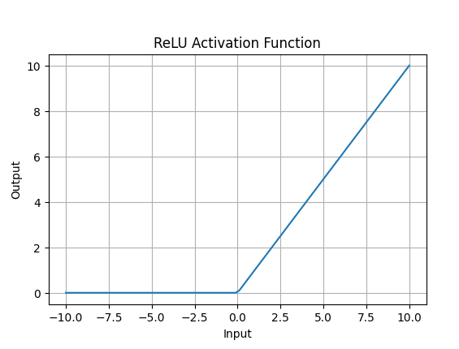
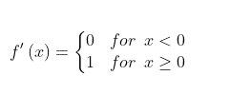
ReLU (Rectified Linear Unit) Function
ReLU activation is defined by A(x)=max⁡(0,x) ,this means that if the input x is positive, ReLU returns x, if the input is negative, it returns 0
Value Range: (0,∞), meaning the function only outputs non-negative values.
Nature: It is a non-linear activation function, allowing neural networks to learn complex patterns and making backpropagation more efficient

Slide 24
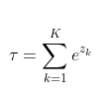
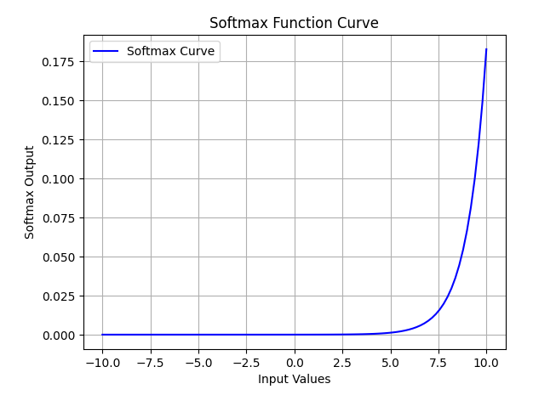
Softmax Function
The Softmax function ensures that each class is assigned a probability, helping to identify which class the input belongs to.

Slide 25
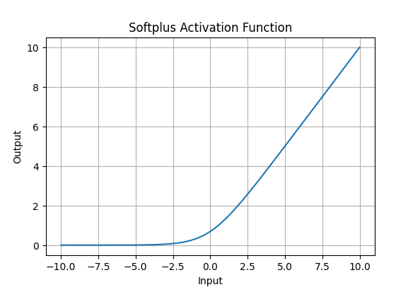

SoftPlus Function
Nature: The Softplus function is non-linear.
Range: The function outputs values in the range (0,∞)(0,∞), similar to ReLU, but without the hard zero threshold that ReLU has.

Slide 26
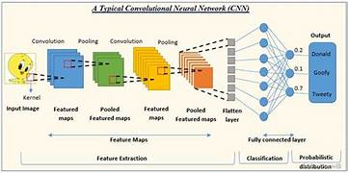

Slide 27
1.The visual cortex has small regions of cells that are sensitive to specific regions of the visual field. Different neurons in the brain respond to different features.
2. ConvNets have shown excellent performance on several applications such as
image classification,
object detection,
speech recognition,
natural language processing, and
medical image analysis

Slide 28
Evolution of Convolutional Neural Network Models
1. LeNet
2. AlexNet
3. VGGNet
4. GoogLeNet
5. ResNet
6. Inception-ResNet
7. Xception

Slide 29
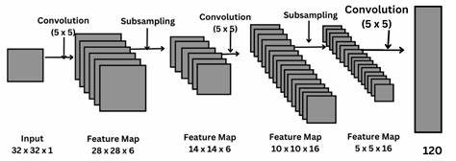
1. LeNet

Slide 30
1.The first practical convolution-based architecture was LeNet which used backpropagation for training the network.
2. The approach did not get much success as it did not scale well to larger problems
Small labeled datasets.
Slow computers.
Use of wrong nonlinearity (activation) function.
3. Vanishing gradient: Vanishing gradient makes it hard to train and tune the parameters of the top layers in a neural network.

Slide 31
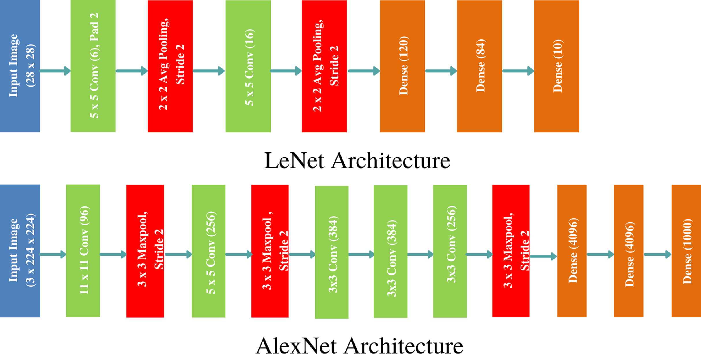
2. AlexNet

Slide 32
ImageNet Large-Scale Visual Recognition Competition (ILSVRC) 2012
2.
a. Large labeled image database (ImageNet), which contained around 15 million labeled images from a total of over 22,000 categories, was used.
b. The model was trained on high-speed GTX 580 GPUs
c. ReLU (Rectified Linear Unit) f (x) max(x, 0) activation function was used. This activation function is several times faster than the conventional activation functions like sigmoid and tanh.
The ReLU activation function does not experience the vanishing gradient problem.

Slide 33
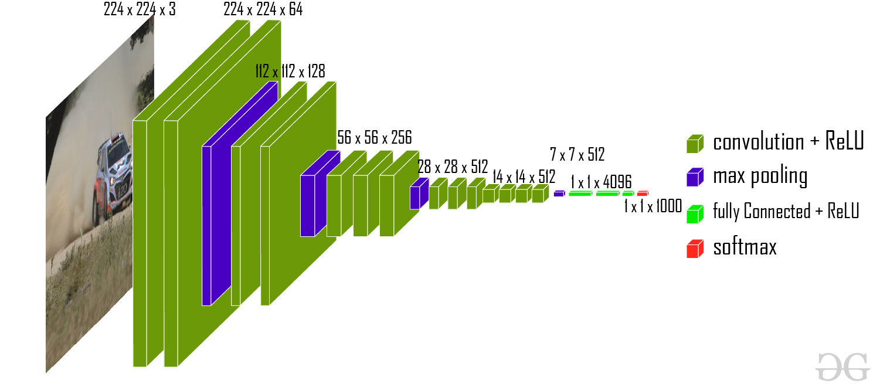
3. VGGNet
Reducing filter size and increasing the depth of the network resulted in CNN architecture that produced more accurate results

Slide 34
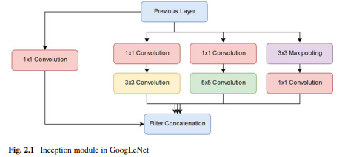
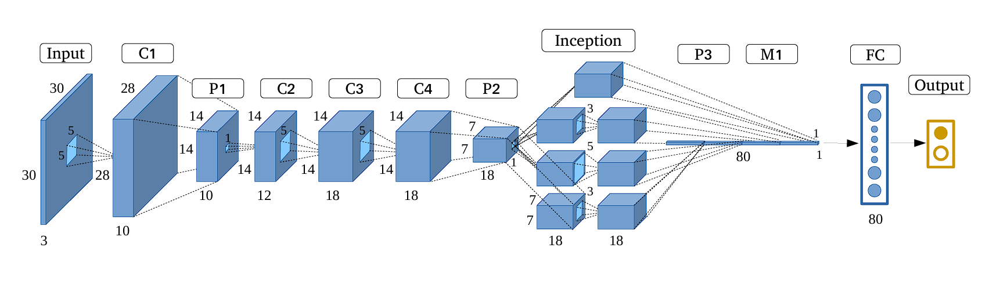
4. GoogLeNet

Slide 35
Increasing the number of layers increases the number of features which enhances the accuracy of the network.
However, there is a practical limitation to that.
a. Vanishing gradients: Some neurons in too deep networks may die during training which can cause loss of useful information and
b. Optimization difficulty: too many parameter eters can make training the network a difficult task.

Slide 36
5.ResNet(Microsoft Research Asia proposed a CNN architecture in 2015)
ResNet introduced residual connections in which the output of a conv-relu-conv series is added to the original input and then passed through Rectified Linear Unit (ReLU)
In this way, the information is carried from the previous layer to the next layer and during backpropagation, the gradient flows easily because of the addition operations
ResNet performed good in classification, detection

Slide 37
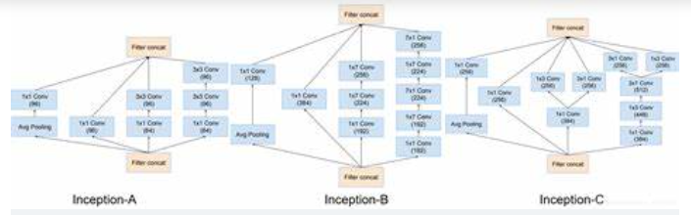
6.Inception-ResNet
This hybrid model called Inception-ResNet dramatically improved the training speed of inception mode

Slide 38
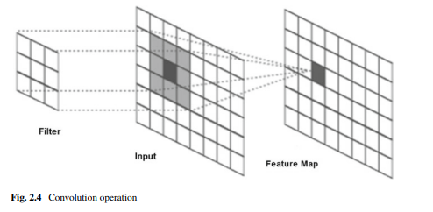
Convolution operation
Convolution operation can be applied to higher dimensional functions
Example: A two-dimensional filter(a two-dimensional input, and a two-dimensional feature map)

Slide 39



Let the 2D input (i.e., 2D image) be denoted by A, the 2D filter of size m × n be denoted by K, and the 2D feature map be denoted by F
This convolution operation is denoted by A*K and is mathematically
The convolution operation is commutative in nature
cross-correlation operation

Slide 40
Architecture of CNN
Layers that sit between the input layer and output layer are called hidden layers. Each hidden layer is made up of a number of neurons, where each neuron is fully connected to all neurons in the preceding layer
ConvNets have three key features: local receptive field, weight sharing, and subsampling
Local Receptive Field
each hidden unit can only connect to a small region of the input called local receptive field
With local receptive field, neurons can extract elementary visual features like edges, corners

Slide 41
(ii) Weight Sharing
ConvNet consists of a sequence of different types of layers to achieve different tasks
A typical convolutional neural network consists of the following layers:
• Convolutional layer,
• Activation function layer (ReLU),
• Pooling layer,
• Fully connected layer and
• Dropout layer(dropout layer to address the overfitting issue)

Slide 42
(iii) Subsampling (Pooling)
Subsampling reduces the spatial size of the input
Reducing the parameters in the network
The most common subsampling technique is max-pooling.

Slide 43
Convolution Layer
Convolution layer is the core building block of a convolutional neural network which uses convolution operation (represented by *) in place of general matrix multiplication.
Its parameters consist of a set of learnable filters also known as kernels.
A feature map is obtained for each filter in the layer by repeated application of the filter across subregions of the complete image,

Slide 44
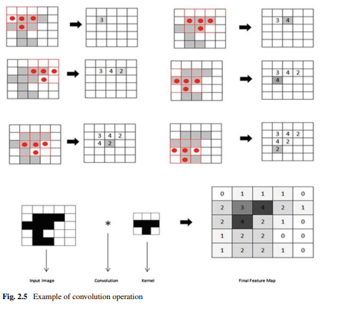

Slide 45
Hyperparameters
Convolutional neural network architecture has many hyperparameters that are used to control the behavior of the mode
Filter Size: Filters can be of any size greater than 2 × 2 and less than the size of the input but the conventional size varies from 11 × 11 to 3 × 3. The size of a filter is independent of the size of input.
Stride:The value of stride should not be too small or too large. Too small stride will lead to heavily overlapping receptive fields and too large value will overlap less.
Zero Padding:This hyperparameter describes the number of pixels to pad the input image with zeros.

Slide 46
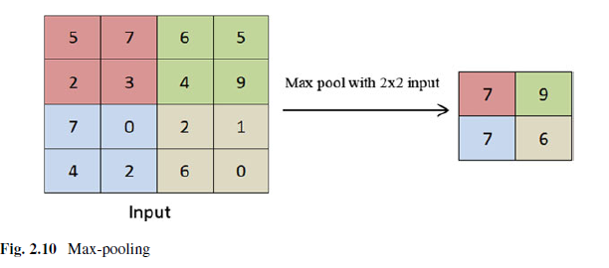
Pooling Layer
the sequence of convolution layer and activation function layer is followed by an optional pooling or down-sampling layer to reduce the spatial size of the input and thus reducing the number of parameters in the network
Max-pooling simply outputs the maximum value in the input region.

Slide 47
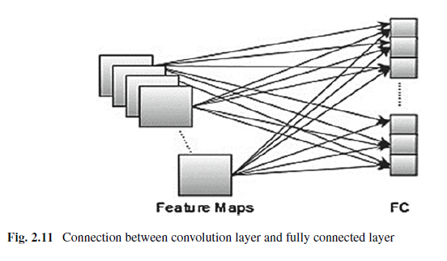
Fully Connected Layer
Convolutional neural networks are composed of two stages: Feature extraction stage and classification stage.
the classification stage is composed of one or more fully connected layers followed by a softmax function layer

Slide 48
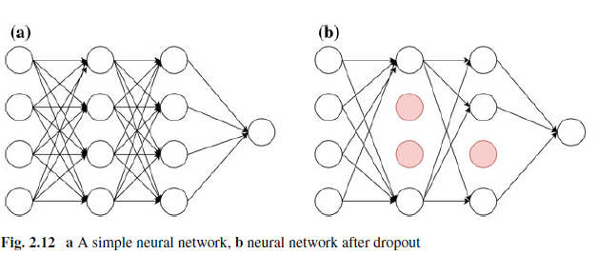
Dropout
A fully connected layer is connected to all features, and it is prone to overfitting. Overfitting refers to the problem when a model is trained and it works so well on training data that it negatively impacts the performance of the model on new data
A reduced network is left; incoming and outgoing edges to a dropped-out node are also removed

Slide 49
Challenges and Future Research Direction
Overfitting
Computation speed
Large dataset
Time complexity

Slide 50
Module-3
Training Supervised Deep Learning Networks

Slide 51
3.1 Introduction
Training supervised deep learning networks involves obtaining model parameters using labeled dataset to allow the network to map an input data to a class label.
The deep model parameters allow the network to correctly determine the class labels for unseen instances.

Slide 52
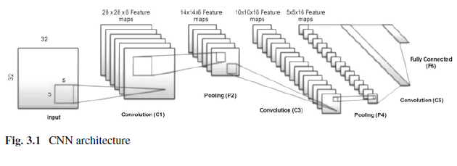
Training Convolution Neural Networks

Slide 53
1)Training supervised deep neural network is formulated in terms of minimizing a loss Function
2) training a supervised deep neural network means searching a set of values of parameters (or weights) of the network at which the loss function has minimum value.
3) Gradient descent is an optimization technique which is used to minimize the error by calculating gradients necessary to update the values
4) The most common and successful learning algorithm for deep learning models is gradient descent-based backpropagation in which error is propagated backward from last layer to the first layer
5) all the weights of a neural network are either initialized randomly or initialized by using probability distribution.
An input is fed through the network to get the output.

Slide 54
1)The CNN model consists of three convolution layers, two subsampling layers, and one fully connected layer producing 10 outputs.

Slide 55
Gradient Descent-Based Optimization Techniques
Gradient descent is an optimization technique used to minimize/maximize the cost function by calculating gradients necessary to update the values of the parameters of the network.
Gradient Descent Variants
Batch Gradient Descent (GD)
Stochastic Gradient Descent (SGD)
Mini-batch Gradient Descent
AdaGrad
AdaDelta
RMSProp
Adam

Slide 56
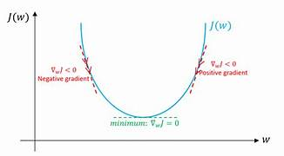
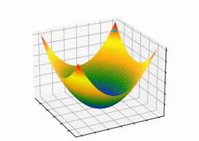
Gradient Descent Variants

Slide 57

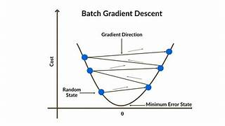
Gradient Descent Variants
Batch Gradient Descent (GD):Depending on the amount of data, we trade off between the accuracy of parameter updates (weights and biases) and the time it takes to perform an update(one parameter update per epoch)

Slide 58
weight parameter w is computed for the entire training set
where ∇E(w) is the error gradient with respect to weight w
μ is the learning rate that defines the step size to take along the gradient
The learning rate is a hyperparameter which cannot be too high or too low.
Large value of learning rate can miss the optimum value, and too low learning rate will result in slow training time.

Slide 59
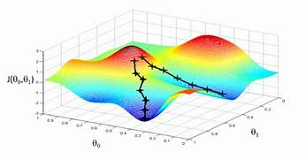

Stochastic Gradient Descent (SGD)
The problem can be rectified by using Stochastic Gradient Descent (SGD),also known as incremental gradient descent, where gradient is computed for one training example at a time followed by updating of parameter values. where ∇E(w; x(i); y(i)) is the gradient of loss function—E(w) w.r.t parameters w,for the training example {x(i), y(i)}.

Slide 60

Mini-batch Gradient Descent
Mini-batch gradient descent also known as mini-batch SGD is a combination of both standard gradient descent and SGD techniques.
Mini-batch SGD divides the entire training set into mini-batches of n training examples and performs the updating of parameter values for each mini-batch.

Slide 61
Typical mini-batch size varies from 50 to 256 and should also be chosen sensibly
according to the following factors:
• Large batch sizes provide more accurate gradients but have high memory requirements.
• Small batch sizes can offer a regularizing effect but require a small learning rate to maintain stability owing to the high variance in the estimate of the gradient.
This in turn increases the training time because of the reduced learning rate.

